Slide 1
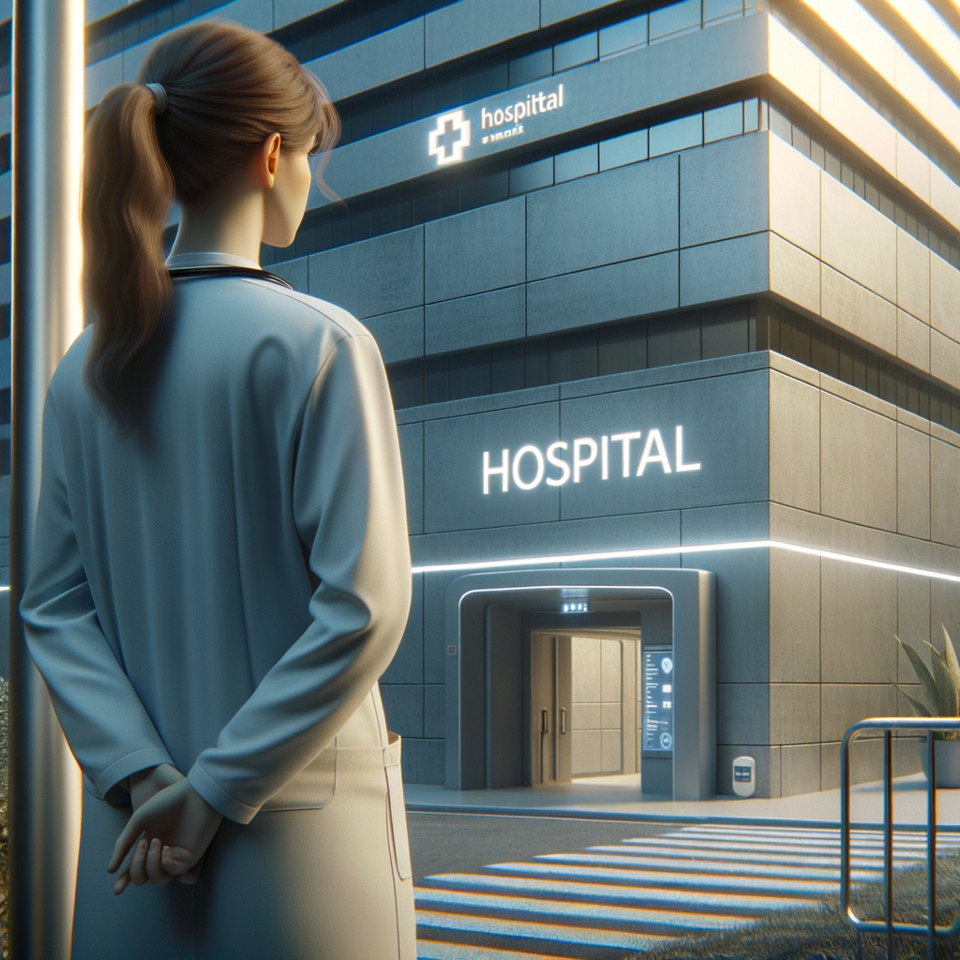
COMP 4431 Artificial Intelligence
Group Project Storyboard Presentation
Group 5
CUI Zhaoyu 22102947d
KONG Zirui 22103493d
Zeng Tianyi 22098941d
Zhu Jin Shun 22101071d

Slide 2
COMP 4431 Artificial Intelligence
Group Project Video
A common day of Dr. Sarah
Group 5
CUI Zhaoyu 22102947d
KONG Zirui 22103493d
Zeng Tianyi 22098941d
Zhu Jin Shun 22101071d
Faculty Advisor
Dr. Pang

Slide 3
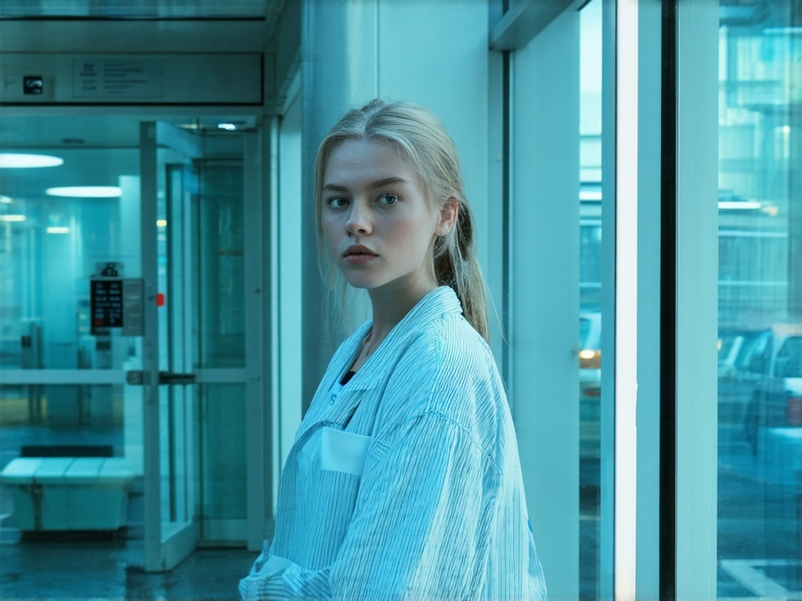
Background
Theme: Future Life with AI
Time: Oct 20th, 2060
Location: London, The United Kingdom
Protagonist: Dr. Sarah
A common day of Dr. Sarah working in Queen Mary's Hospital

Slide 4
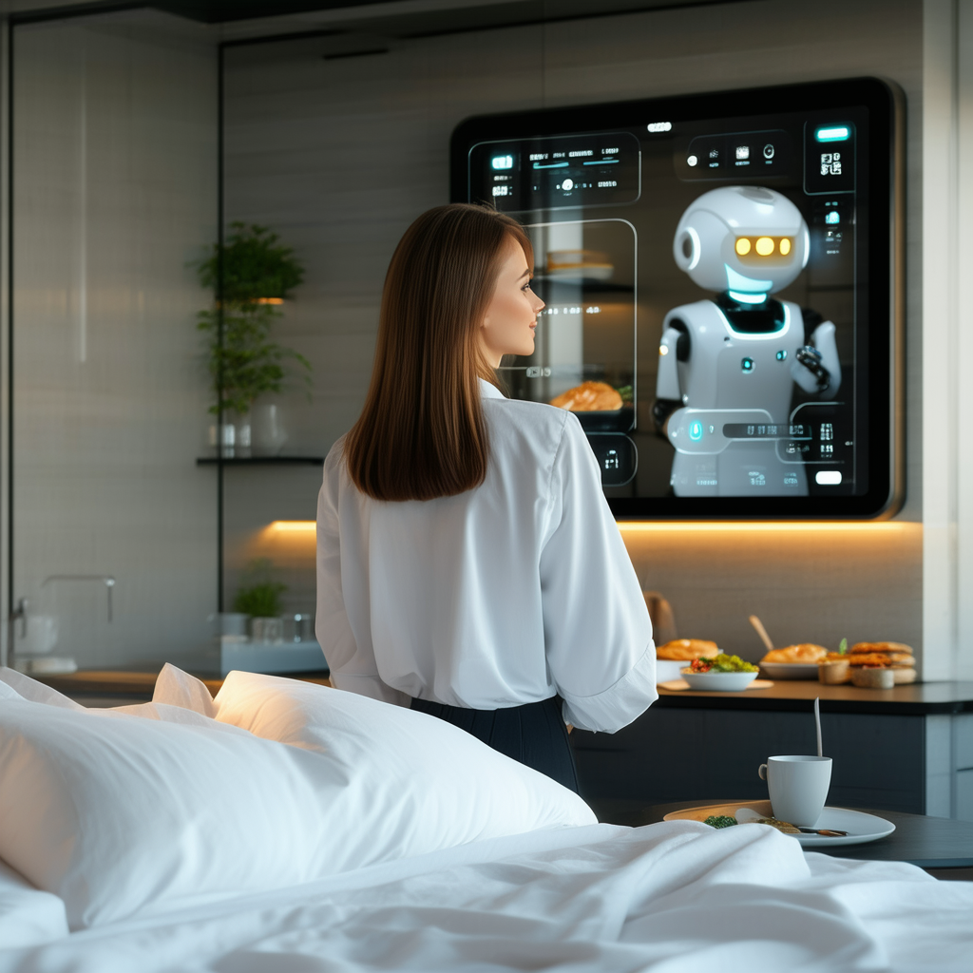
Scene 1: Morning Routine
Time: 7:00 a.m.
Location: Bedroom
Introduction: Dr. Sarah wakes up to a gentle voice from her AI assistant, reminding her of her schedule and suggesting a healthy breakfast based on her dietary preferences.

Slide 5
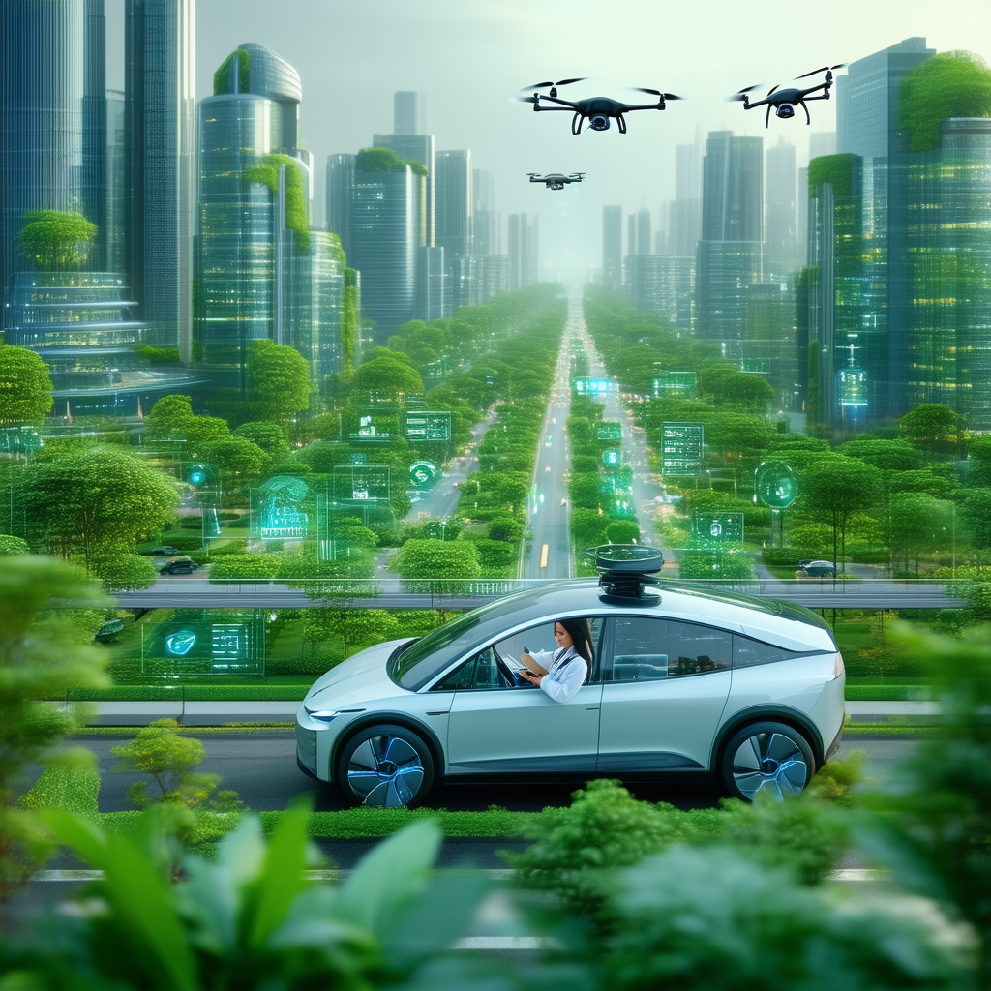
Scene 2: Commute to Work
Time: 8:30 a.m.
Location: Way to Work
Introduction: Dr. Sarah reviews patient files on her tablet while the car drives itself. The AI provides traffic updates and suggests the best route.

Slide 6
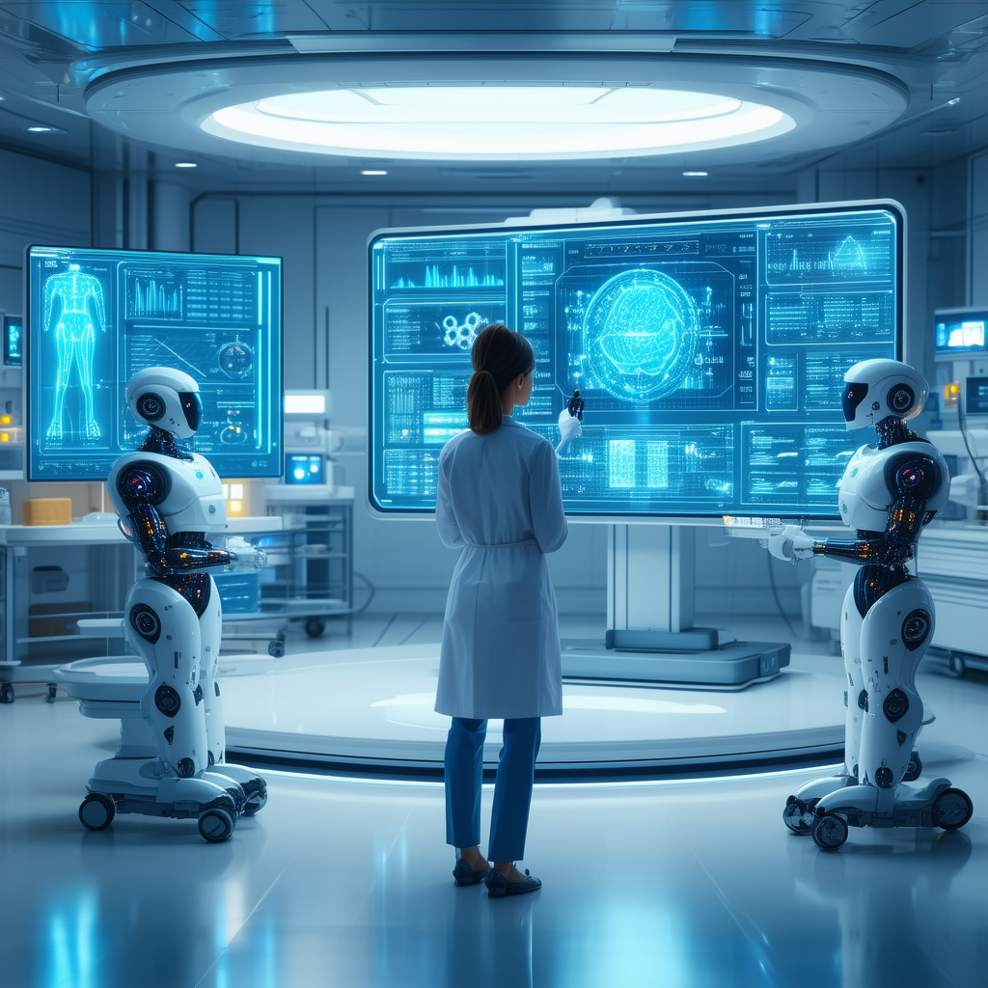
Scene 3: AI in the Hospital
Time: 10:00 a.m.
Location: Office
Introduction: Dr. Sarah consults with an AI diagnostic tool that analyzes patient symptoms and suggests potential diagnoses from the data received yesterday.

Slide 7
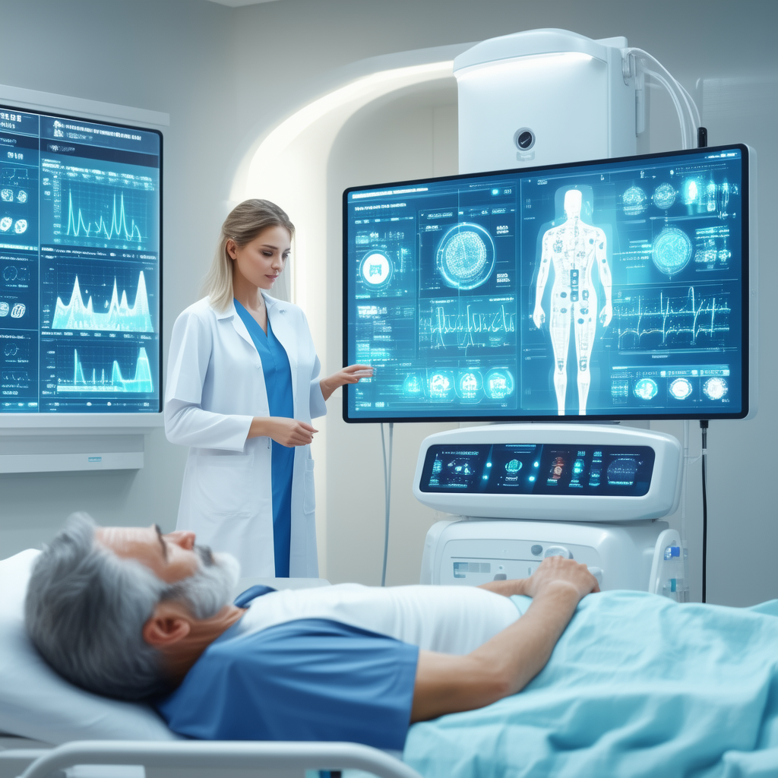
Scene 4: Patient Interaction
Time: 11:30 a.m.
Location: Surgical ward
Introduction: Dr. Sarah uses an AI-powered health monitor to gather detailed health metrics from a patient. The AI provides insights based on the data collected.

Slide 8
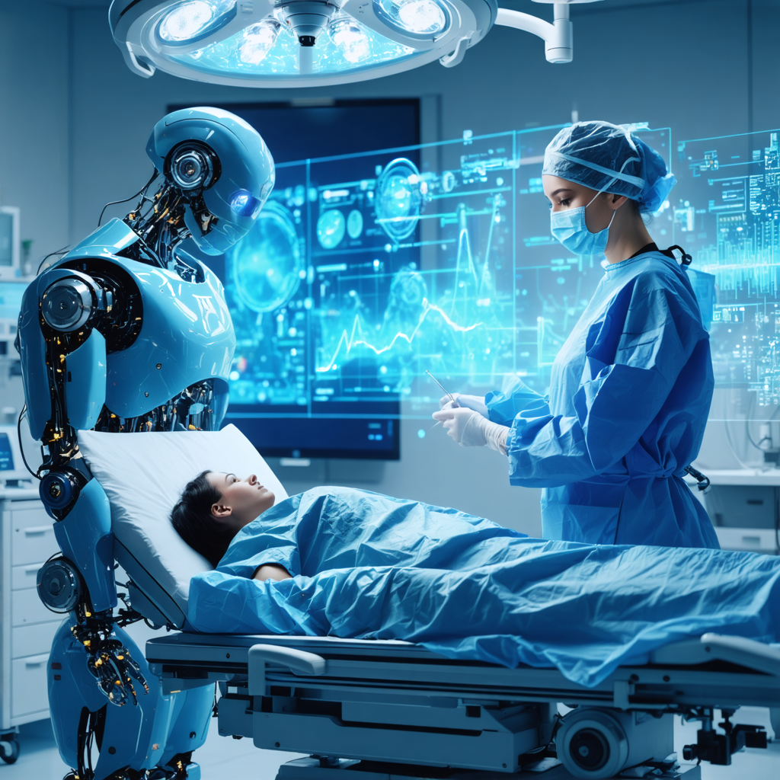
Scene 5: Collaborative Surgery
Time: 01:00 p.m.
Location: The Operating Room
Introduction: Dr. Sarah performs surgery with the assistance of a surgical robot powered by AI, which enhances precision and minimizes risks.

Slide 9

Scene 6: Research and Development
Time: 04:30 p.m.
Location: Data analysis room
Introduction: Dr. Sarah collaborates with AI researchers to analyze large datasets for medical research, discovering new treatment.

Slide 10
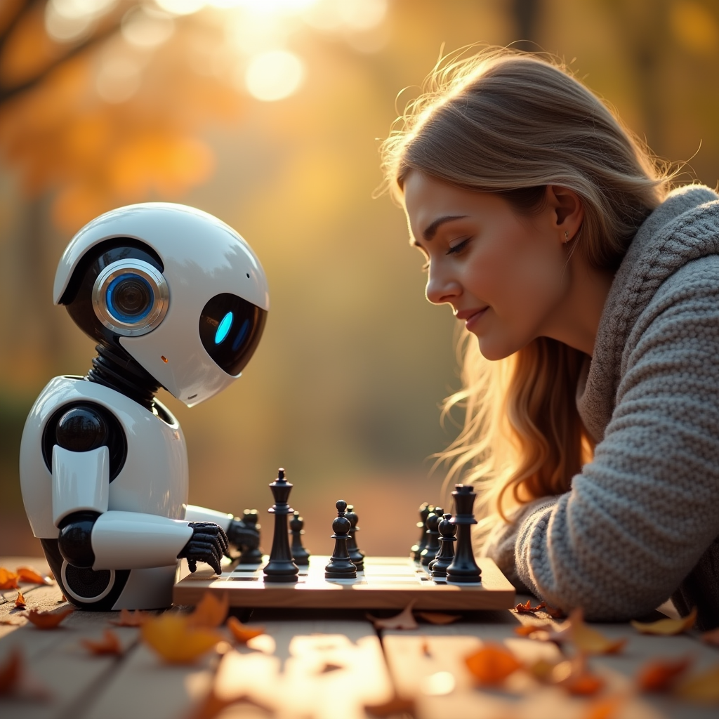
Scene 7: Leisure activities after work
Time: 05:30 p.m.
Location: Park
Introduction: Dr. Sarah plays chess in the park with an AI robot after work.

Slide 11
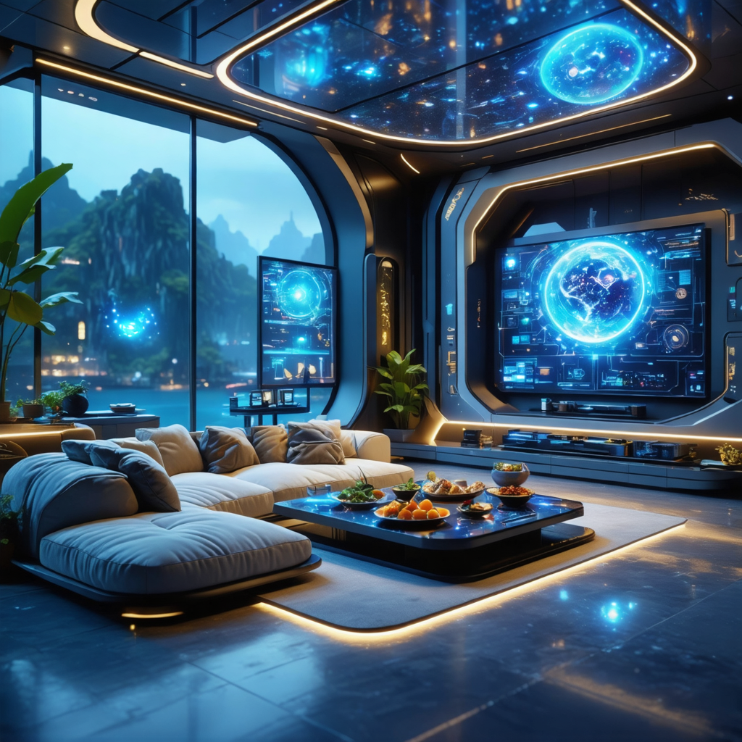
Scene 8: Evening Routine
Time: 07:00 p.m.
Location: Living room
Introduction: Dr. Sarah collaborates with AI to prepare dinner and projects on the window a beautiful landscape videos, creating a calming atmosphere.

Slide 12
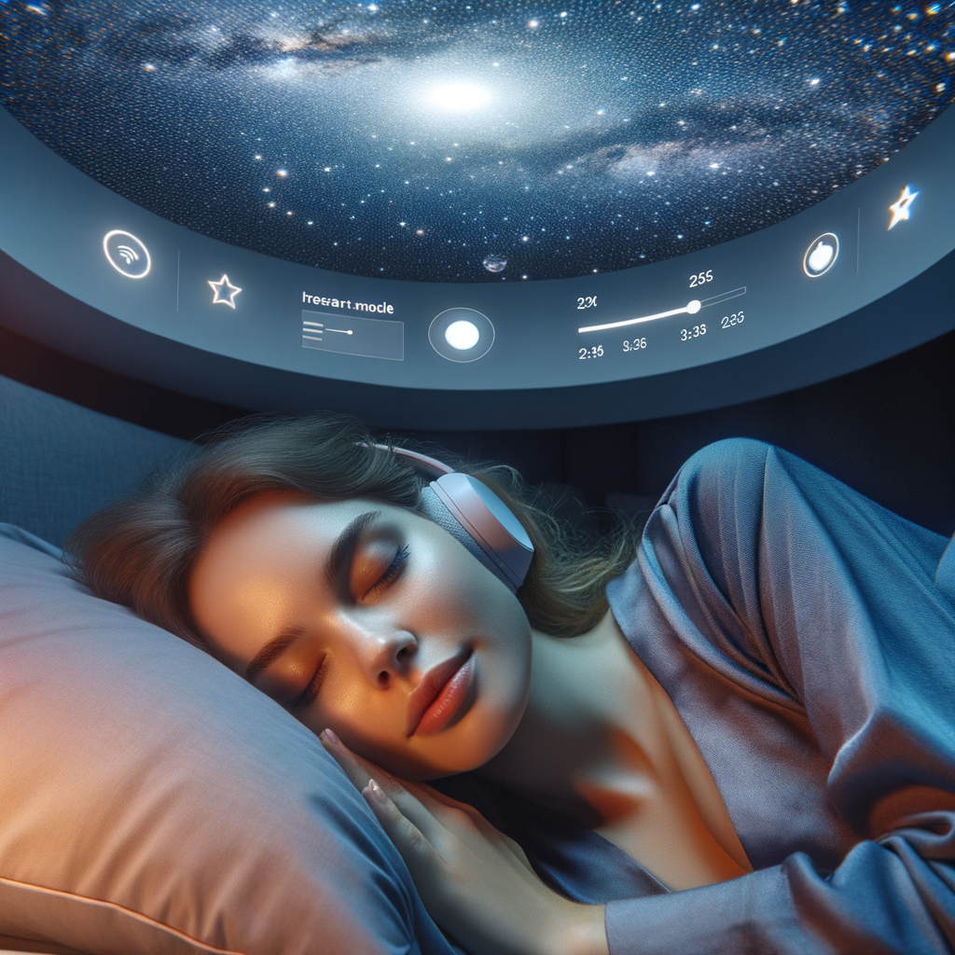
Scene 9: End of a day
Time: 10:00 p.m.
Location: Bedroom
Introduction: Dr. Sarah collaborates with AI to a project a Starry sky environment and goes to sleep peacefully.

Slide 13
Thank You !

Slide 14
Acknowledgements COMP4431 2025 Spring Group Project Future Life with AI : A common day of Dr. Sarah
Group 5
CUI Zhaoyu 22102947d
KONG Zirui 22103493d
Zeng Tianyi 22098941d
Zhu Jin Shun 22101071d
Faculty Advisor
Dr. Pang

